Slide 1
Master-Thesis Methodical Approach for Analyzing Process Parameters and Optimizing Boundary Conditions in Mutli-Axis Robot Programs
Status Update: Week 03
16.10.2023 – 22.10.2023
Jan Nalivaika

Slide 2
Recap : Week_02
VIP:
Aufgabenstellung
Anmeldung
Vereinbarung
Exposee
Not VIP
NX
Table of Content

Slide 3
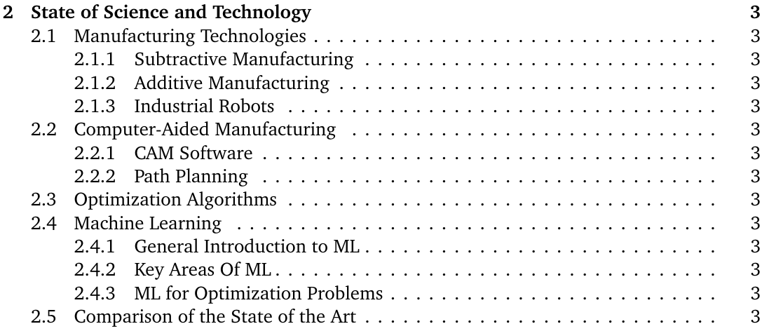
Table of Content

Slide 4
Idea
Robot
Path
Simulation
Testing
on system
Manufacturing
Part
Optimal Parameters
Extract Data
(Predictions)
Extract Physical Values
Comparison
Analysis

Slide 5
Idea – Evaluation of a toolpath
Count direction changes
Siemens NX
Toolpath
Get joint movement
Get Acceleration
Get Jerk
Calculate extension
Calculate Stiffness
Calculate Energy use
Check I close to singularity

Slide 6
Contact
Jan Nalivaika (TUM) Student Otto-Hahn-Ring 6
81739 Munich, Germany
Phone +49 163 7180148
E-mail jan.nalivaika.ext@siemens.com nalivaika@outlook.de
Marius Breuer (Siemens AG)
Supervisor Otto-Hahn-Ring 6
81739 Munich, Germany
Phone +49 (172) 8396287
E-mail marius.breuer@siemens.com
Ludwig Siebert (TUM-IBW)
Supervisor Boltzmannstr. 15
85748 Garching at Munich
Phone +49 (89) 289 – 15578
E-mail ludwig.siebert@iwb.tum.de

